Slide 1
Chemical Storage Locker - Electronic Measurements & Sensors Project -
Teacher: Dr. Ing. Rodica Holonec
Students:
Paul Mădăras – 30424 Paul Iordache – 30424
Sebastian Mureșan – 30424 Mara Mureșan – 30423
12.01.2024

Slide 2

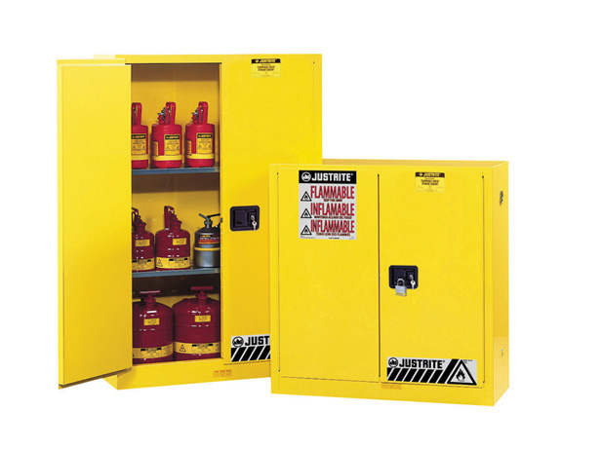
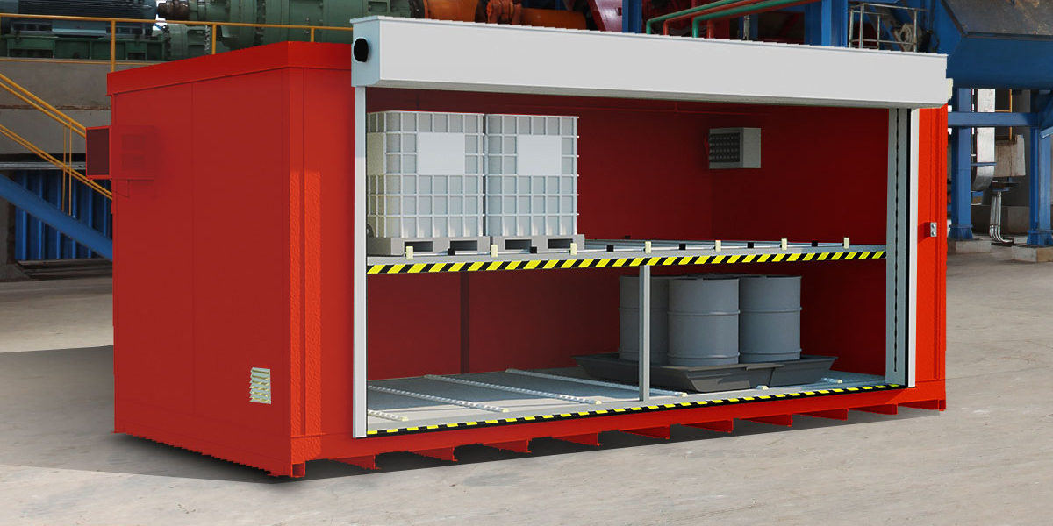
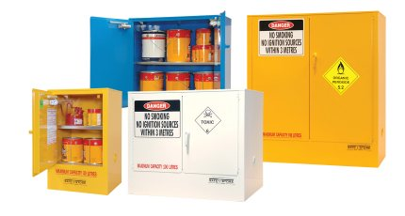
Enhancing Safety and Security
specialized system → ensure the safe and secure containment of various chemicals within a controlled environment
mishandling of chemicals → serious risk to personnel/environment
=> goal: SMART and RESPONSIVE setup that
MONITORS & SAFEGUARDS
the storage environment of potentially hazardous substances

Slide 3
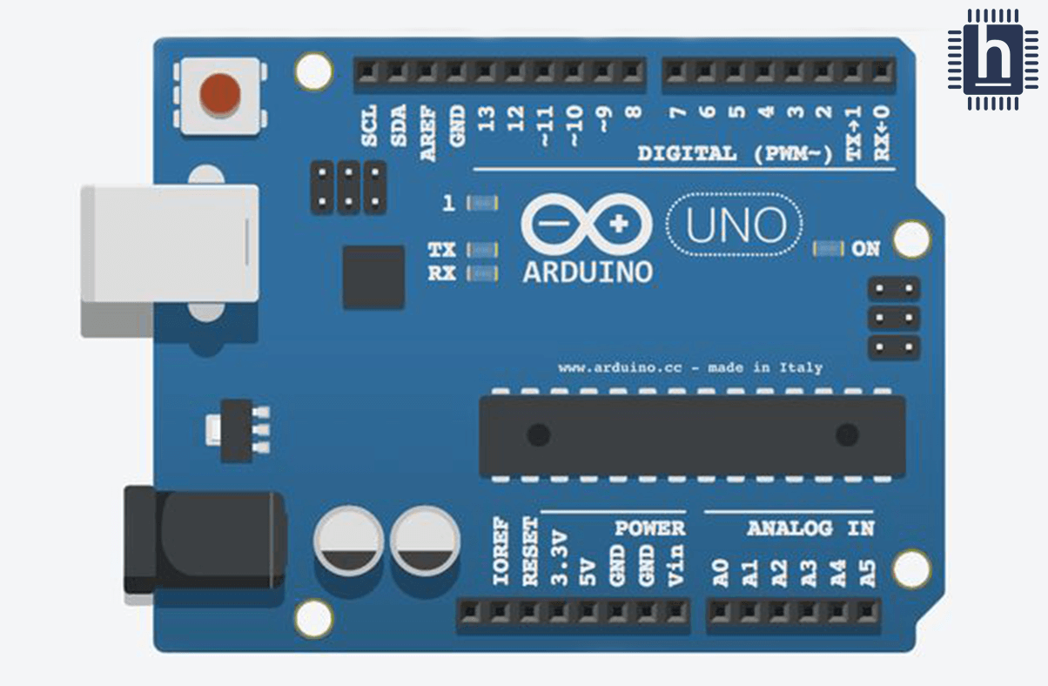
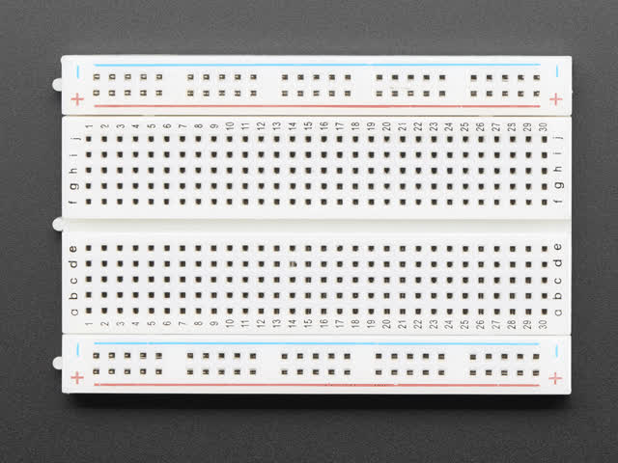
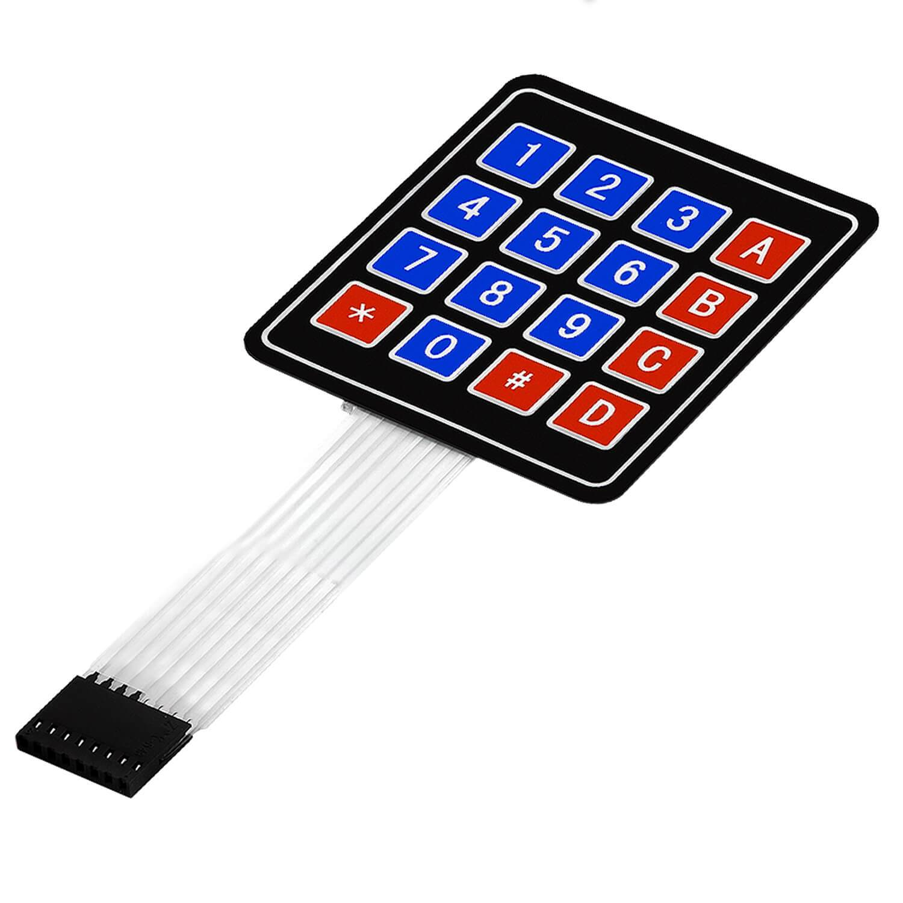
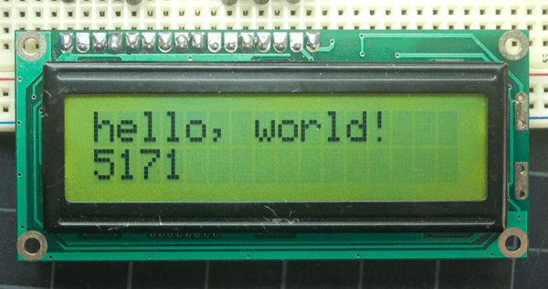
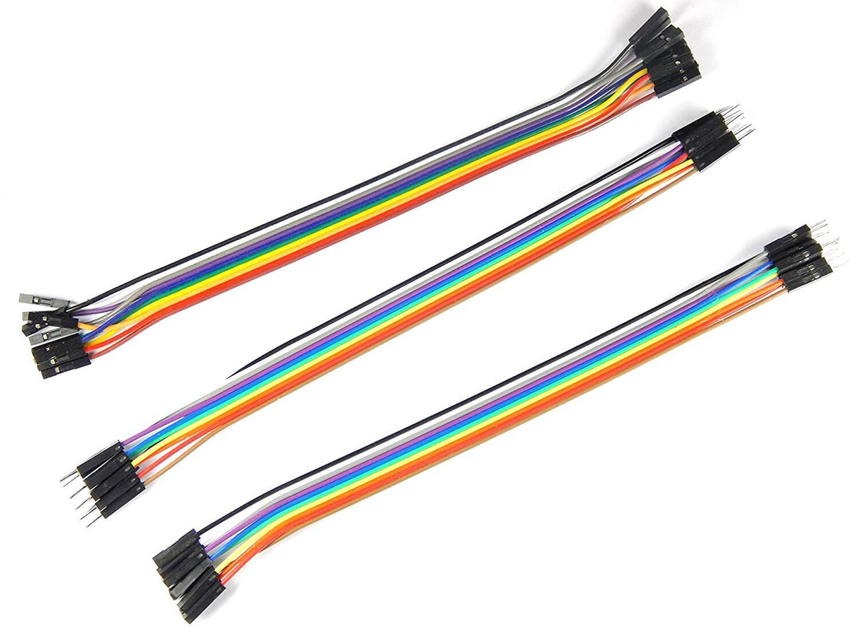
Project Overview
Arduino Components:
Arduino Microcontroller
Breadboard
Keypad
LCD Display
Wires

Slide 4
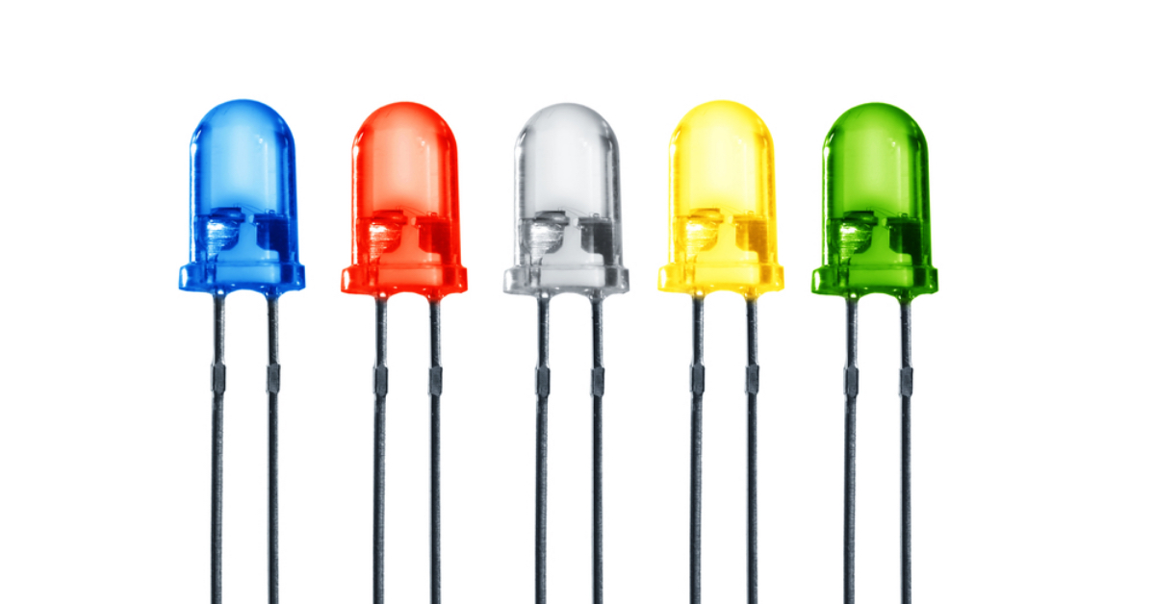
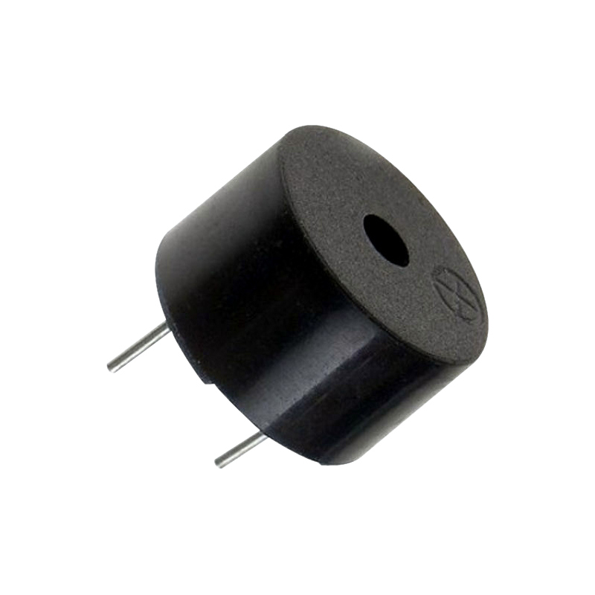
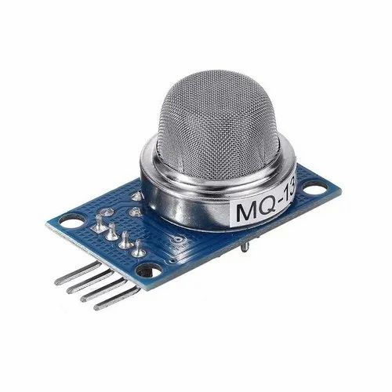
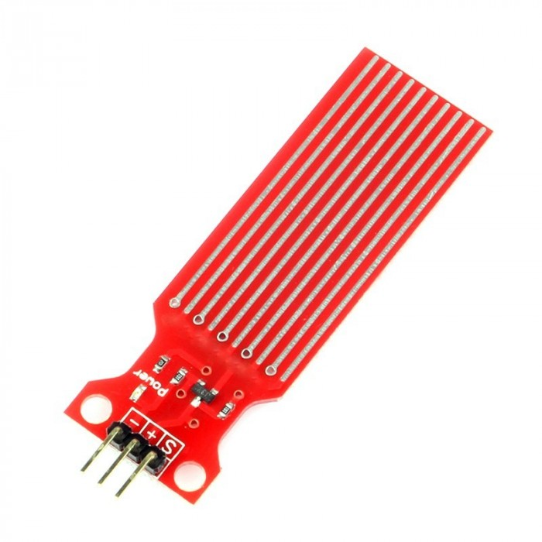
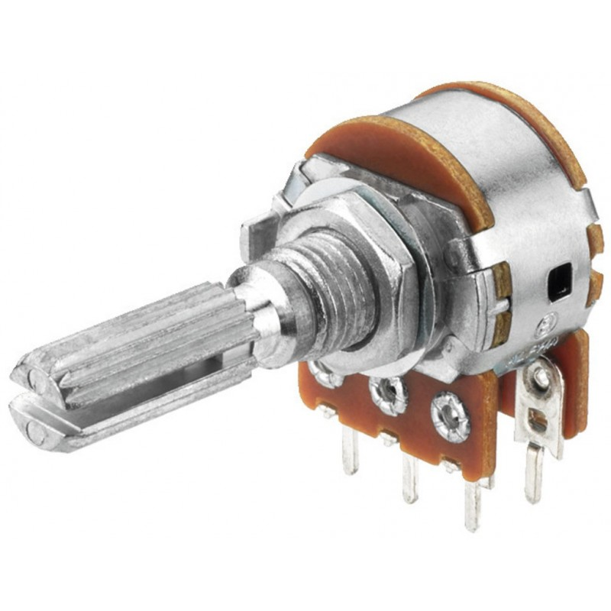
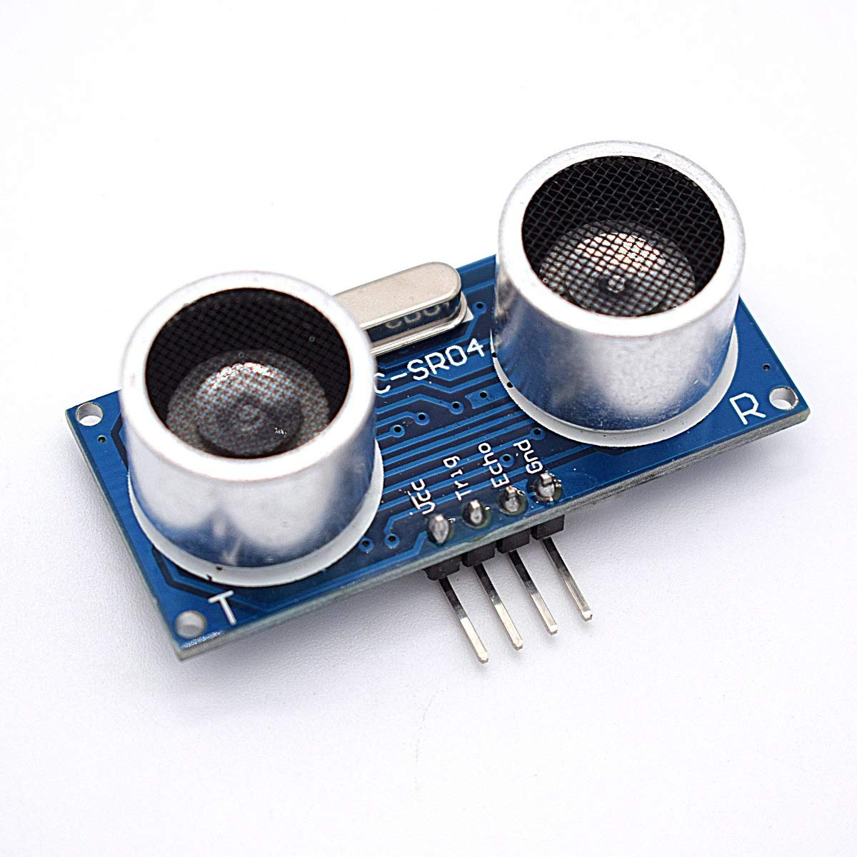
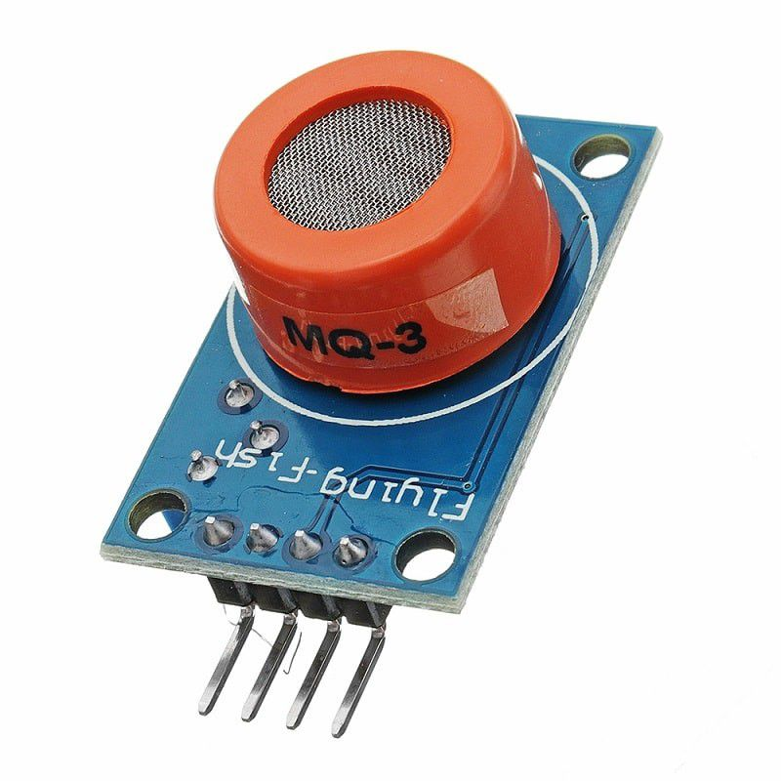
Potentiometer
Actuators
LEDs
Buzzer
Sensors
Alcohol Gas Sensor
Air Quality Sensor
Ultrasonic Sensor
Water Level Sensor

Slide 5
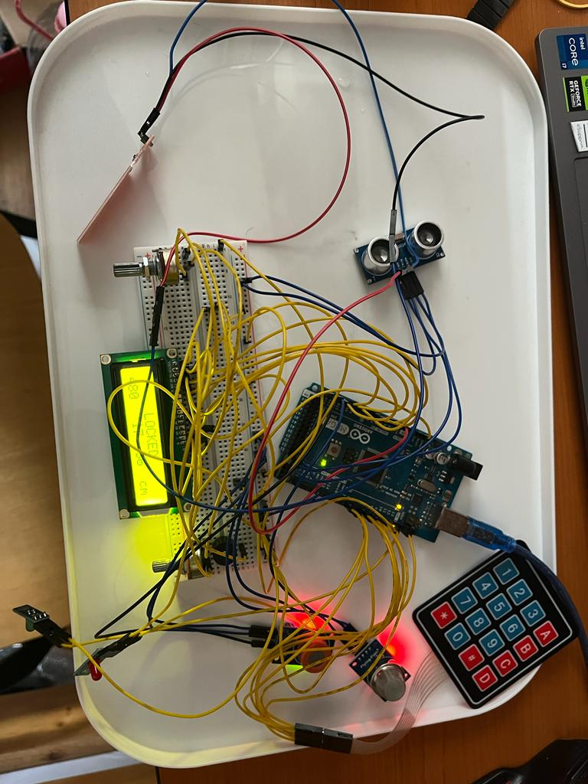
Working Principle
The main component → LOCKER
Additional component → SUBSTANCES LEAKAGE DETECTION SYSTEM
Enter a passing code
INCORRECT => the RED light is ON and the Buzzer starts, locker remains CLOSED
CORRECT => the GREEN light is ON, UNLOCK the storage
Gas Detection
ALCOHOL => print the level value
SMOKE, AMMONIA, SULFUR, BENZEN => print the level value
Water Detection
The Buzzer starts & RED light is ON, LOCK the storage
Motion Detection

Slide 6


Advantages
Prevention of Accidents
Cost-Effective Safety Measure
Compliance with Safety Standards
Efficient Resource Management
User Empowerment

Slide 7


Possible Developments
The same locker and sensors could be used for a car locking system that doesn’t allow the driver to open the car if the value measured by the alcohol sensor is over a previous stated threshold.

Slide 8

Thank You!

